Slide 1

HYDRODYNAMICS OF STIRRED TANK REACTOR
Submitted by
M.Sai Siddartha (234107110)
Basu Basumatry (234107201)
Md.Zaffar Zeshan (234107202)
P.Venkata Satyanarayana (234107207)
P.Vignesh Prabhu (234107208)
CL-654 Multiscale and Modelling

Slide 2
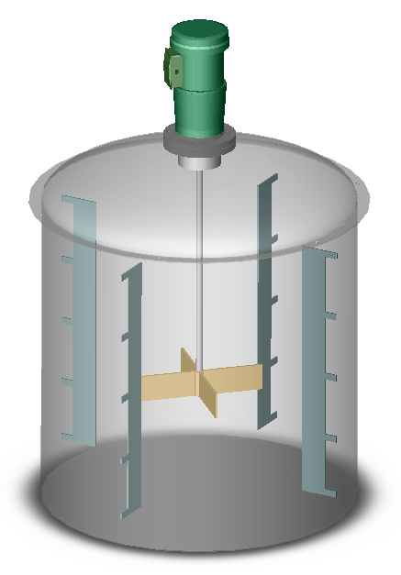
Stirred Tank Reactor
A stirred tank contains of three major components,
1. Vessel
2. Baffle
3. Bladed Impeller
Credits: https://www.sciencedirect.com/topics/engineering/stirred-tank

Slide 3
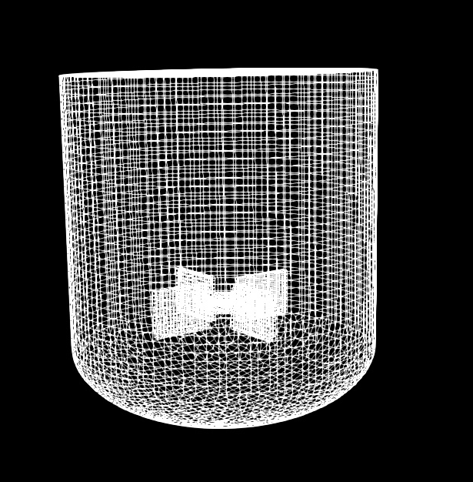
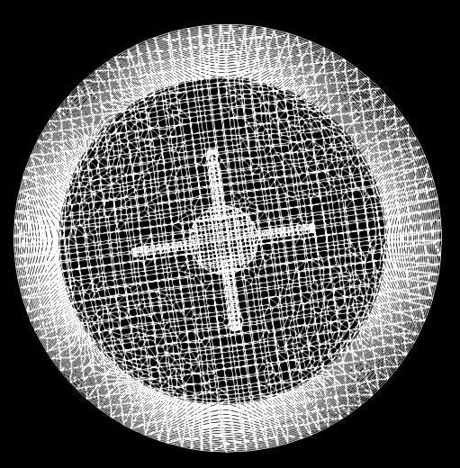
How to Simulate the Stir tank
Multiple reference frame
Rotating frame
Stationary frame

Slide 4
Solver SIMPLE
SIMPLE: Semi-Implicit Method for Pressure-Linked Equations
The SIMPLE algorithm is a widely used method for solving the Navier-Stokes equations, which govern fluid flow, in a computationally efficient manner. It is particularly effective for incompressible flows. The method iteratively solves for the velocity and pressure fields in a staggered grid arrangement.

Slide 5
Contour plot of Velocity in Horizontal Plane

Slide 6
Contour plot of Velocity in Vertical Plane

Slide 7
Contour plot of Pressure in Vertical Plane

Slide 8
Contour plot of Pressure in Horizontal Plane

Slide 9
Plot of Velocity and Pressure in Horizontal Plane

Slide 10
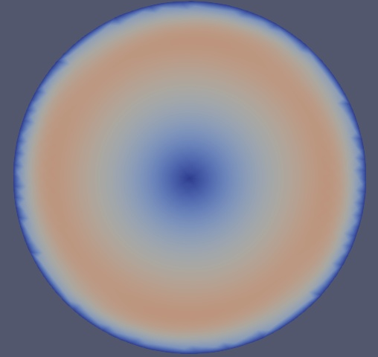
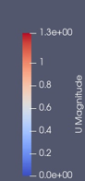
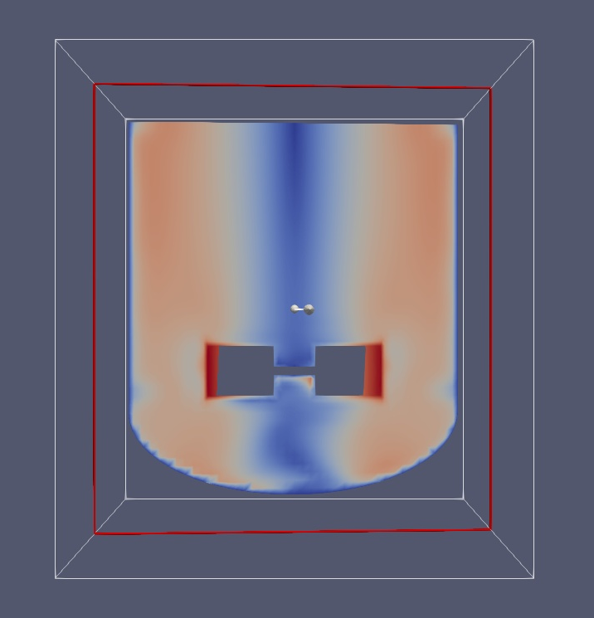
Results
Time | Velocity in X direction | Velocity in Y direction | Velocity in Z direction
250 | 0.0179 | 0.092 | 0.017
500 | 0.022 | 0.112 | 0.0082
750 | 0.021 | 0.11 | 0.020
1000 | 0.021 | 0.1099 | 0.0196

Slide 11
Thank You

